Slide 1
Goodbye EPAT!
Welcome XPM.
Extension Performance Management (XPM)

Slide 2
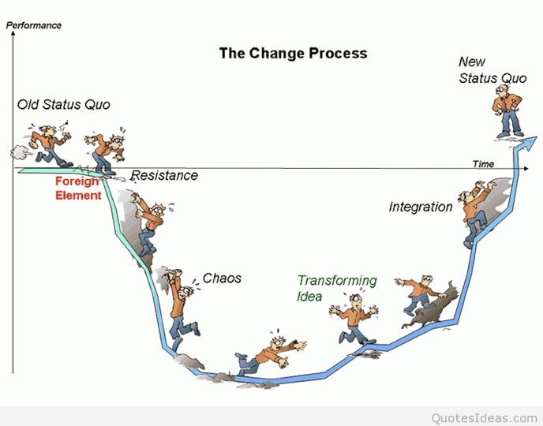
Change is a Process...
There may be bumps and bruises along the way.
But in the end it will be worth the effort.

Slide 3
Why Change What We Were Doing?
The UNC System adopted regulations in 2017 to streamline annual performance evaluations.
Those changes were first implemented in Extension with COSS personnel using the SHRA evaluation tool.
PA/Agent/CED scores in the old EPAT tool were mapped to align with the UNC System scores required.
We now have to achieve compliance with the regulation.

Slide 4
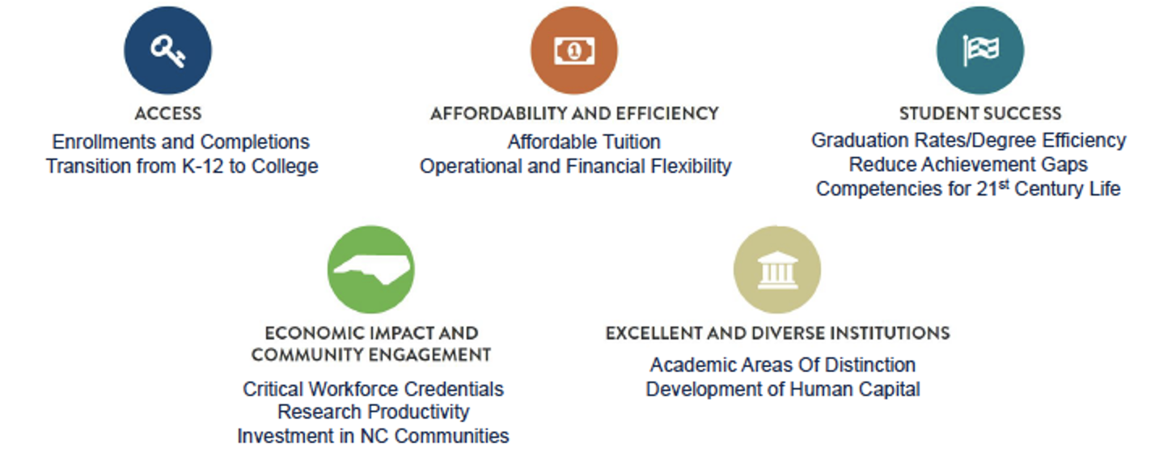
UNC System-wide Strategic Initiatives

Slide 5
NC State University Strategic Goals
Empower students for a lifetime of success and impact.
Ensure preeminence in research, scholarship, innovation and collaboration.
Expand and advance our engagement with and service to North Carolina and beyond, defining the standard for a 21st-century land-grant university.
Champion a culture of equity, diversity, inclusion, belonging and well-being in all we do.
Improve university effectiveness through transformative technologies, cutting-edge processes and actionable data.
Lead in developing innovative partnerships, entrepreneurial thinking and applied problem solving.
Elevate the national and global reputation and visibility of NC State.

Slide 6
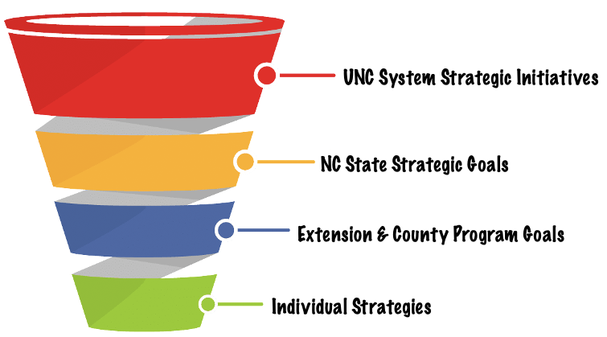

Slide 7
Anticipated Changes
Simpler evaluation process
Results-based approach
Focus on areas for development
Decoupled County Plan of Work
Multiyear Individual Plan of Work

Slide 8
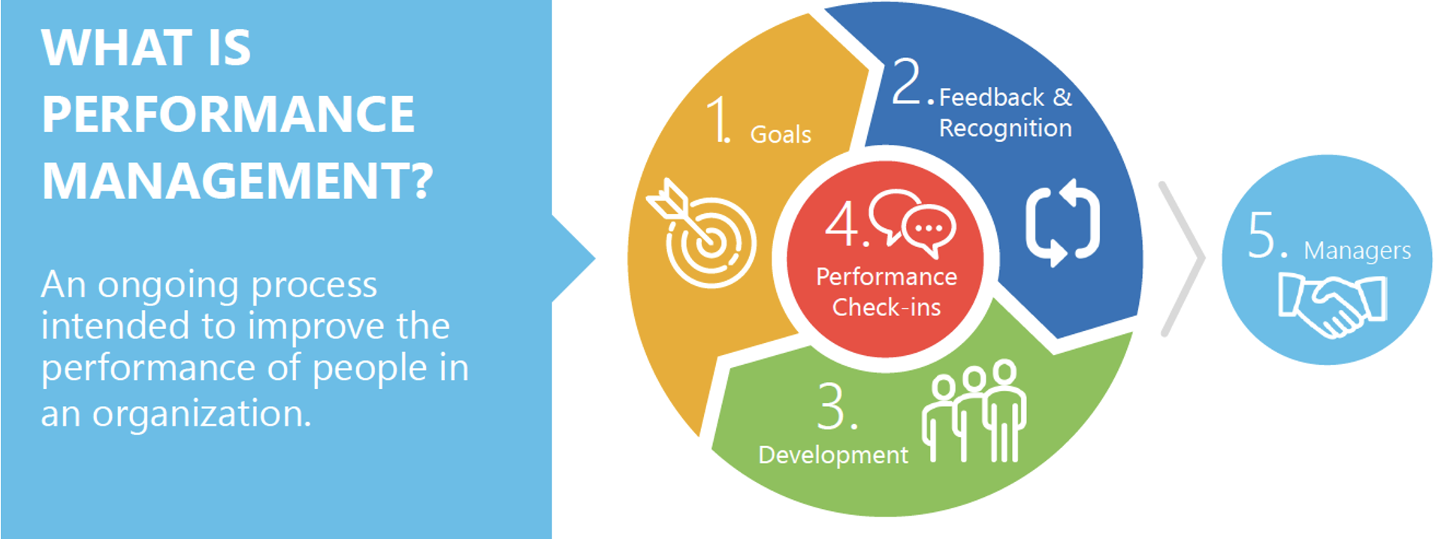

Slide 9
Performance Evaluation Cycle
Performance Evaluation Activity | Timeline/Due Date
Performance Evaluation Cycle Begins | July 1, 2021
Supervisors Meet with Employees To Establish Goals & Objectives and Professional Development Activities | July 2021
Interim/Mid-Year Evaluations Due | January 31, 2022
Performance Cycle Concludes | June 30, 2022
Annual Agent Evaluations Due | July 15, 2022
CED Evaluations Due / Overall Ratings Due To EHR | July 31, 2022
NOTE: ERS reporting timeline does not change

Slide 10
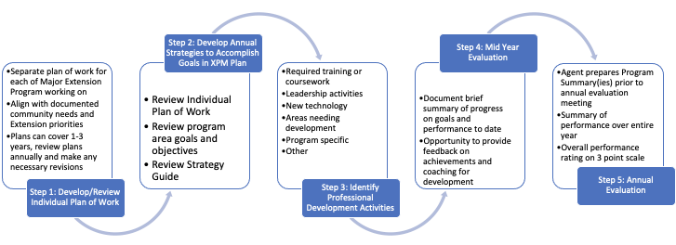
Recognition
Feedback
Feedback
Recognition
Feedback
Feedback
Feedback
Recognition
Recognition
Feedback
Feedback
Recognition

Slide 12
Individual Plan of Work
Long-range (1-5 yr) comprehensive program plan that can be modified annually as necessary.
The plan of work identifies the problem being addressed, who will be served by the program, any program partners, the program goal and outcomes, program activities, an evaluation plan, and marketing plan.
A plan is developed for each of the major program areas.

Slide 13
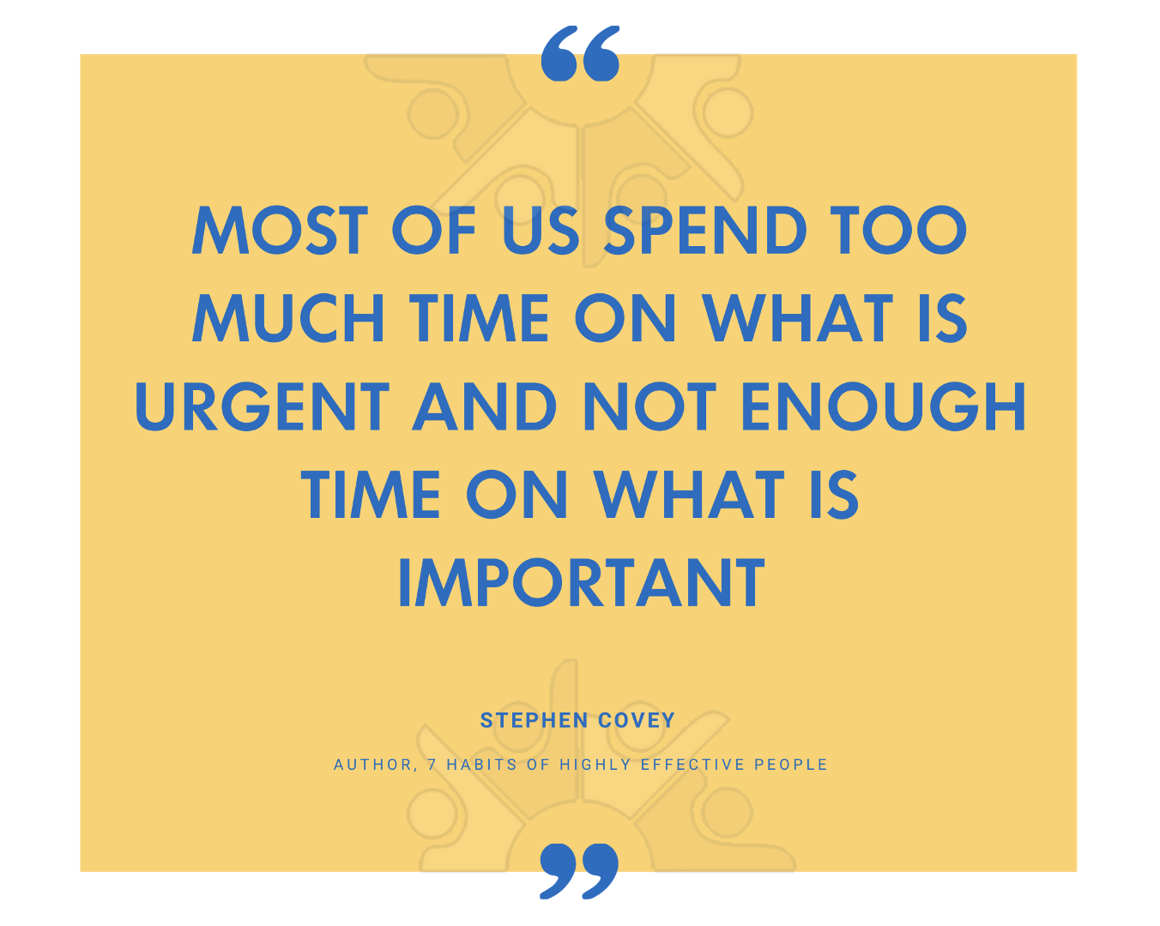
Resources Available
https://evaluation.ces.ncsu.edu/xpm/
Statewide Program Goals and Objectives
Guidelines for Writing an Individual Plan of Work
Individual Plan of Work worksheet

Slide 14
2021-2024 Statewide Goals - ANR
Improve crop production efficiency through increased yields, improved quality, and decreased input costs.
Increase profitability of animal agriculture, equine, and forage production.
Increase profitability and efficiency across all areas of the horticulture industry through adoption of recommended Best Management Practices (BMPs).
Enhance food safety throughout the supply chain through producer and consumer-based programming aimed at preventing food safety hazards.
Sustain the quality and diversity of North Carolina’s natural resources by conserving and protecting the environment, boosting sustainable energy and mitigating climate change.

Slide 15
2021-2024 Statewide Goals - FCS
Enhance food safety throughout the supply chain through producer and consumer-based programming aimed at preventing food safety hazards.
Reduce chronic disease risk and food insecurity by promoting policies, environments, and education that sustain healthy behaviors through the consumption of healthy diets, active lifestyles, access to nutritious food and the achievement and maintenance of healthy body weights.
Empower individuals and families to build healthy lives and achieve optimal social and economic wellbeing

Slide 16
2021-2024 Statewide Goals - 4-H
Provide opportunities for all youth, ages 5 – 18, to identify their passions or Spark and develop life-skills that prepare them for future success.

Slide 17
2021-2024 Statewide Goals - CRD
Catalyze NC’s local economies to be attractive places to live, work, and play.
Amplify capacity of NC’s leaders, organizations and communities to ensure sustainable and equitable prosperity for all North Carolinians.
Strengthen NC’s infrastructure and resilience to build on technological opportunity and meet rapidly shifting climate impacts, demographics, workforce health and safety, and consumer demands that build the future economic, health and social well-being of NC communities.
Create opportunities for resilient local food systems that promote increased production, processing, marketing, and consumption of food that is grown, caught, and raised within North Carolina.

Slide 18
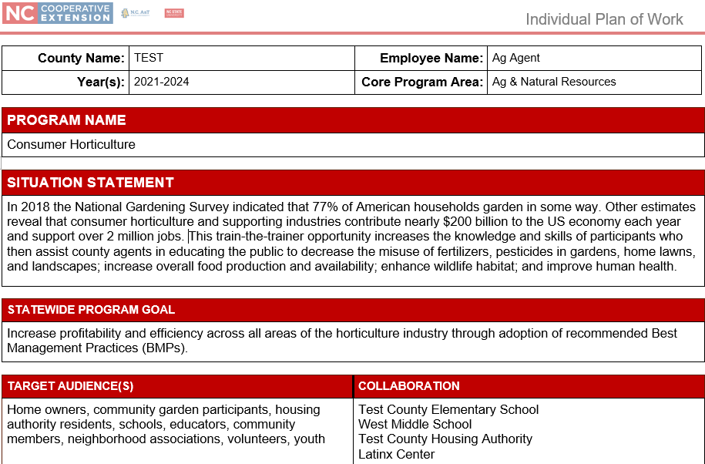

Slide 23
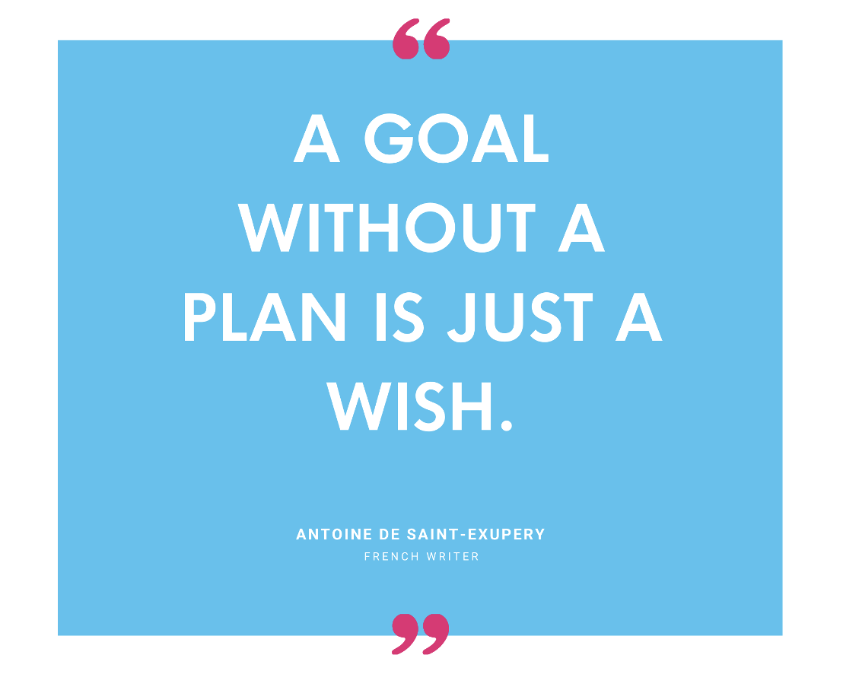
After consulting with the supervisor, the employee will enter the XPM system and list their strategies and professional development activities for the upcoming year.
The supervisor will then have the opportunity to make any edits and approve the XPM.

Slide 24
Institutional Goals
Additional Institutional Goals: Accountability, Customer-Oriented, Team-Oriented, Compliance & Integrity

Slide 25
Program Goals
 | Program Planning
 | Program Delivery
 | Evaluation
 | Marketing

Slide 26
Individual Strategies
Review Individual Plans of Work
Review Program Area Goals, Strategic Initiatives or Mandates
Review County Goals, Strategic Initiatives or Mandates
Develop SMART strategies that will assist in achieving the program goals listed in XPM
Strategies should not be “standard” job tasks that repeat year after year
27

Slide 27
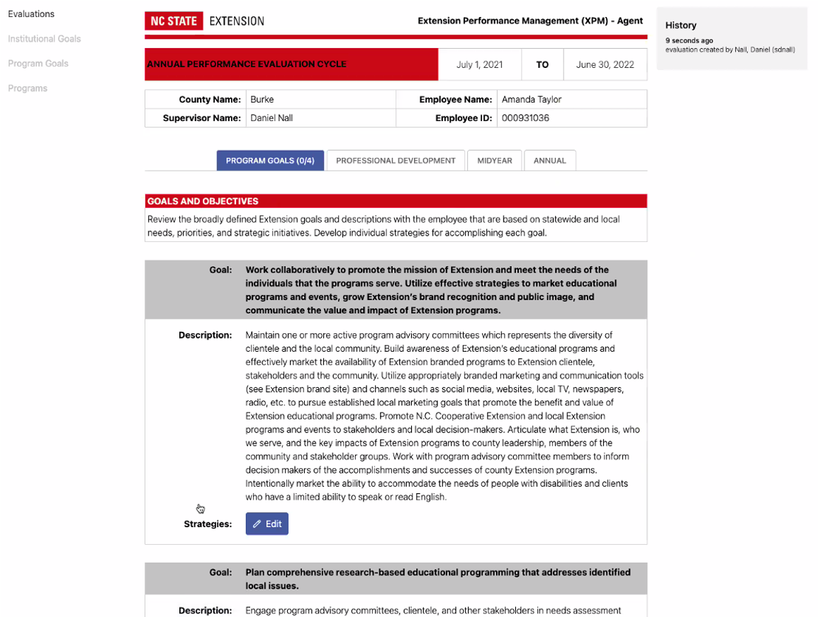
Strategies
Agents add annual strategies for each goal

Slide 28
SMART Strategy Development

Slide 29
XPM GOAL
Program Planning: Plan comprehensive research-based educational programming to address identified local issues.
Description: Work with program advisory committees, clientele, underserved audiences and other stakeholders to identify and prioritize local issues and educational needs. Develop a comprehensive Extension program using a program planning framework. Use Extension developed or approved curricula, Extension publications and other research-based content appropriate for the intended audiences or work with campus Specialists to adapt or identify content as needed. Review programming to ensure it meets Extension program policies including issues of branding, programs with minors, copyright infringement, Americans with Disabilities Act (ADA) inclusion, use of the non-discrimination statement and accommodation statement, limited English proficiency requirements, etc.
By August 1 review the composition of all program advisory committees and make necessary adjustments to recruitment and selection so all program advisory groups are representative of the county or area served.
By December 31 work with program advisory committee/stakeholder groups to identify target populations and underserved groups in the community, identify ways to provide targeted outreach to these populations, provide outreach, and track success of these outreach methods.
By March 1 meet with your program advisory leadership committee to plan a program needs assessment. By May 30 conduct a needs assessment to identify the priority educational program needs within the county. Use this information to update your Individual Plan of Work.
30

Slide 30
Professional Development Plan
Diversity, Equity & Inclusion Training
Update your Personal Development Record in OSS
Discuss and document any plans for training and development opportunities in the XPM
Graduate coursework is required every 5 years until achieving the rank of Full Agent.
Include required and recommended DEI trainings

Slide 31
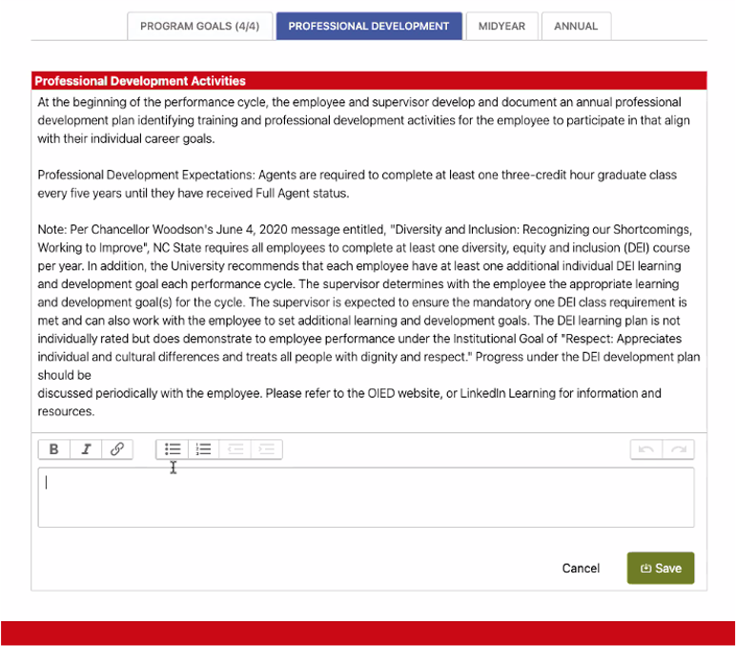
Professional Development
Professional development activities are added

Slide 33
Interim/Mid-Year Evaluation
Document check-ins between CEDs and Agents to discuss the employee’s performance
CEDs may discuss Agent progress in meeting expectations outlined in goals, strategies, or professional development activities

Slide 34
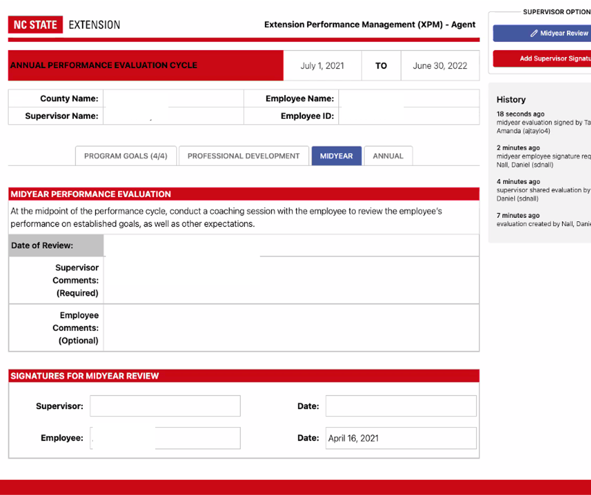
Midyear Evaluation
Add Mid-Year comments
Digitally sign
Evaluation is then sent to agent for comment and signature

Slide 35
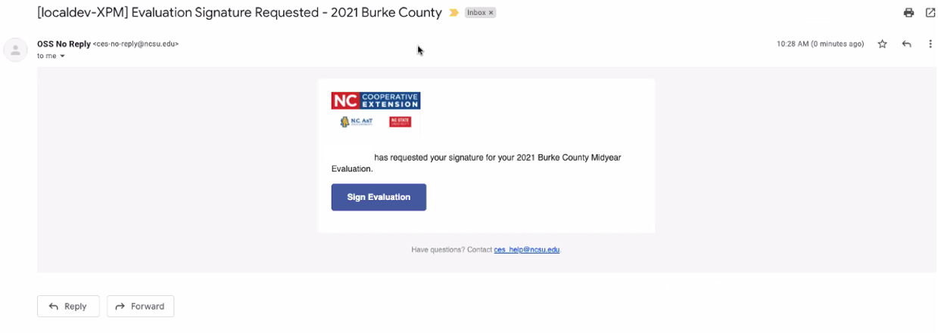
Communications & Signatures
Agent receives email notification
Agent logs into XPM system, reviews mid-year evaluation, enters comments (optional) and digitally signs mid-year evaluation.

Slide 37
Summarizing Your Annual Program Activity
Agents provide Program Summary to CED prior to the final performance review meeting
Maintain an electronic copy of all Program Summaries for use in future title promotion packages

Slide 38
Program Summary
PROGRAM IMPLEMENTATION
Describe the educational strategies and teaching methods (meetings, field days, news articles etc.) used and how they fit together as part of the comprehensive educational program. Describe the target audience(s) and how they were identified. Did you expand your audience or reach new audiences for your program; if so, how? Provide evidence of diversity and balanced programming efforts. Describe your internal/external collaborations, networking and partnerships involved. What role did you play? Include funding that was utilized or any grants and other resources you secured.
PROGRAM OUTCOMES & IMPACTS
Describe the results of your program evaluation in terms of: What difference did this program make in the lives of the participants or North Carolina citizens? Include changes in the target audiences’ knowledge, skills, attitudes, and changes in behavior/practices or adoption of technology or innovations. Include data reported in ERS and results from qualitative and quantitative evaluations.

Slide 39
PROGRAM MARKETING
How was this program marketed to your target audience? What media outlets or networks were used to help market the program? What promotional tools did you use to maximize the reach and impact of your programming (e.g. online marketing, social media, direct mail, etc.)?
PROGRAM DIVERSITY
Provide a demographic comparison of your program participants vs your county population. Is your program in parity? Is there a reason your program cannot achieve parity? What specific measures did you take to increase outreach to underserved audiences and increase program diversity?

Slide 40
Annual Evaluation/Comments
CEDs review and document the Agent’s performance during the entire cycle.
Comments should include outcomes related to the Agent’s goals, strategies, professional development activities and DEI training.

Slide 41
Overall Performance Rating

Slide 42
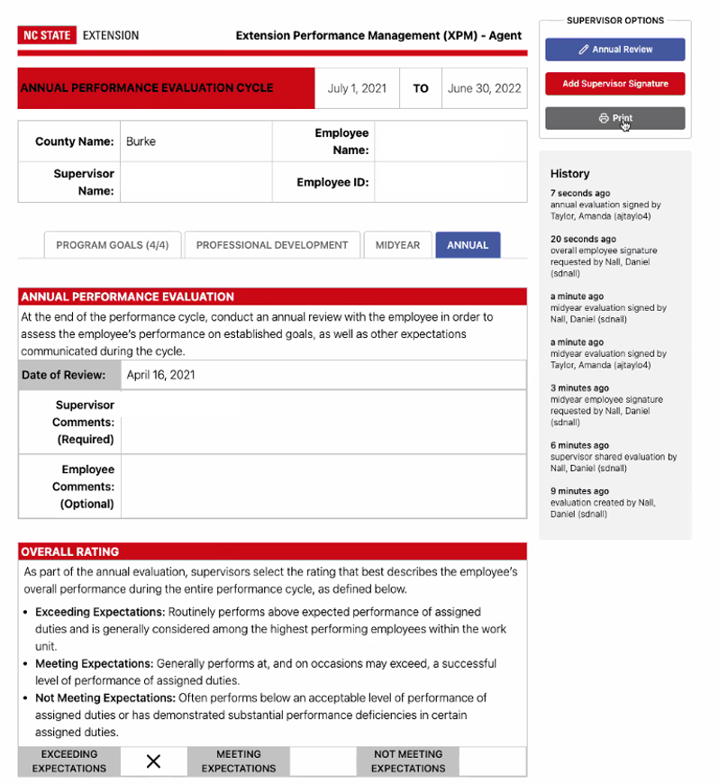
Annual Performance Evaluation
Performance summary and overall performance rating are entered.
CED adds signature and XPM system sends notification to agent.
Agent makes comments (optional) and adds signature.
CED prints document and adds to personnel file.

Slide 43
Overall Performance Rating
The annual overall performance rating represents the CEDs assessment of the Agent’s total performance during the entire evaluation cycle
Employees must be assigned an overall performance rating based on a defined three-point scale
NC State must submit these ratings to the UNC GA every year in August
CEDs meet with the Agent to conduct an annual performance review meeting

Slide 44
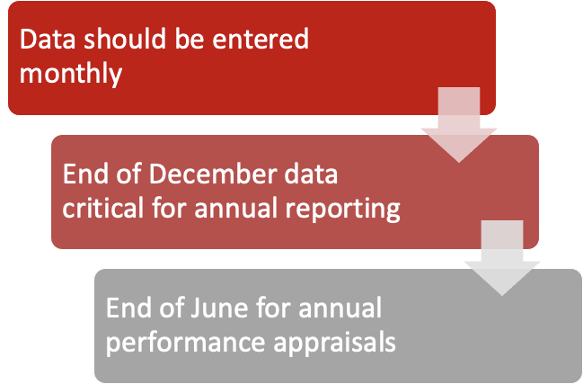
Key Dates for ERS

Slide 45
These slides are for CED training only
HOW TO COMBINE YOUR PROGRAMING GOALS AND STRATEGIES WITH YOUR ADMINISTRATIVE GOALS AND STRATEGIES.

Slide 46
CED PLAN OF WORK
A CED can use the same plan of work form as an Agent for their core program area.
Notes:
Typically, County Extension Directors will focus on one programming area. You will use the same form as an Agent to detail your programming efforts. However, if you have significant efforts in two areas such as 4-H and Community & Rural Development, then you can develop a Plan of Work for each. You will pull from the Individual Plan of Work your strategies for the XPM that will strengthen your programming for the upcoming year.

Slide 47
CED XPM
In addition to the program plan in your focus area, the CED should develop strategies for the three administrative goals in their XPM.
Three Administrative goals will focus on:
Supervision and Leadership
Financial Management
Marketing, Internal/External Relations and Community Engagement

Slide 48
What is the CED process for XPM?
Similar to the Agents the XPM form will change annually and focus on the upcoming year’s strategies to obtain your long to short term goals identified in you plan of work.
But there are differences for the CED...
All strategies for improving programming results will be compiled in one “Program Goal”
Three administrative goals will have separate strategy boxes.

Slide 49
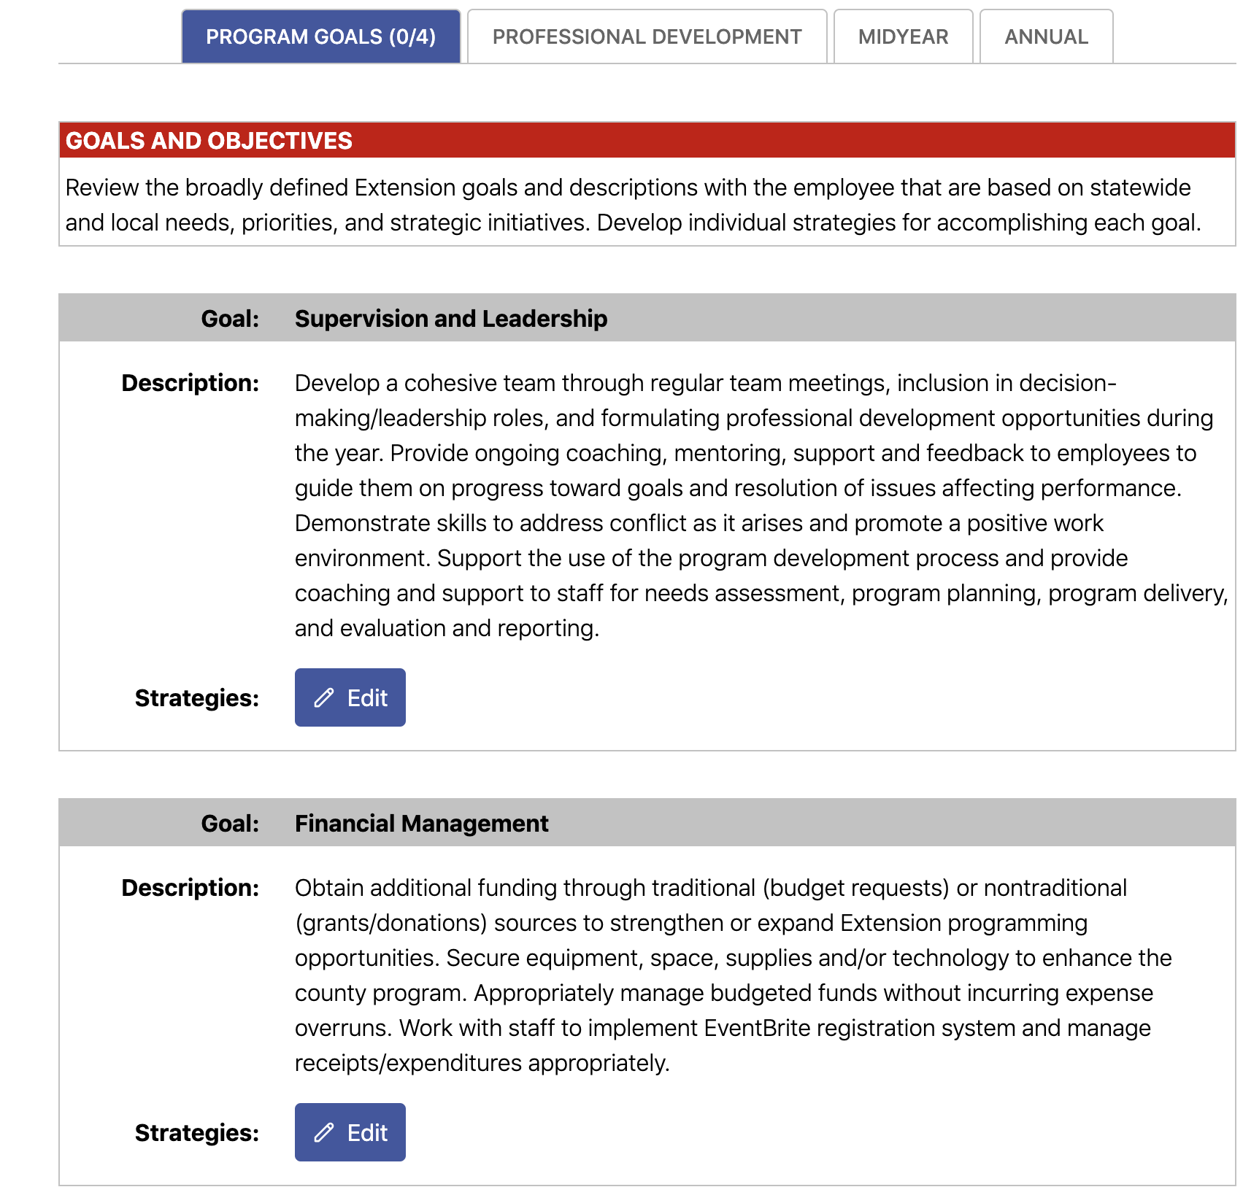

Slide 53
Professional Development
Add professional development activities

