Slide 1
Equal Opportunity
Notes:
Welcome to NC Cooperative Extension’s Equal Opportunity training for volunteers and members of our advisory leadership system.

Slide 2
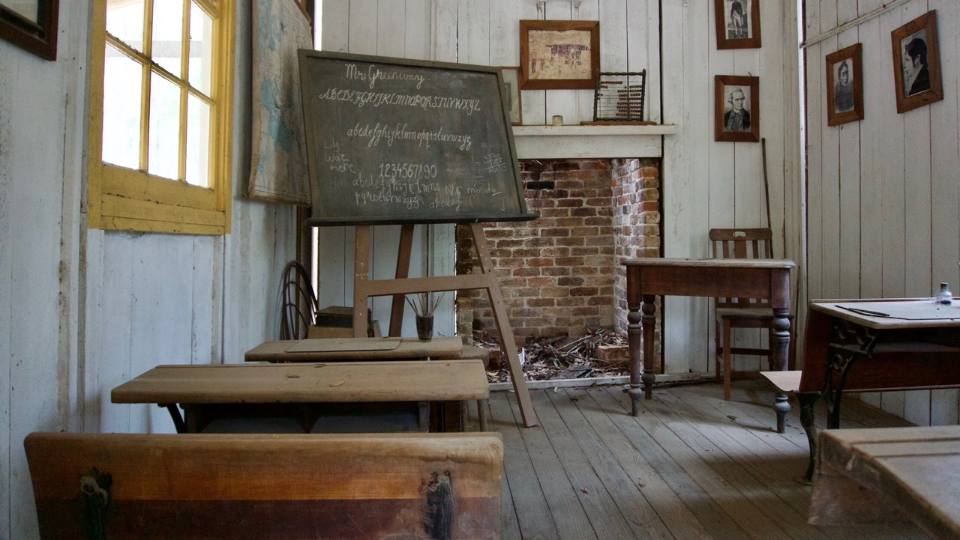
Notes:
All Extension volunteers and advisory leadership system members are provided with an overview of federal civil rights legislation and Extension’s nondiscrimination obligations. This training is designed to ensure that everyone making decisions or carrying out actions on behalf of Extension programs are responsible for providing an equal opportunity for participation.

Slide 3
veteran’s status
religion
genetic information
disability
sex
age
race, color, or national origin
Notes:
NC State policy prohibits unlawful discrimination and harassment based on a person’s protected status. Protected Status is defined as an individual’s actual or perceived race, color, or national origin, including shared ancestry or ethnic characteristics; sex, including sexual orientation, gender identity, and pregnancy or related conditions; age; disability; genetic information; religion; and veteran’s status. This policy applies to all programs, services and facilities.

Slide 4
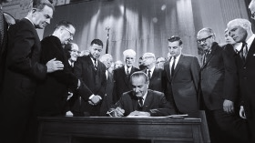
Notes:
The foundation of Extension’s civil rights policies and procedures is the Civil Rights Act of 1964 which states… No person in the United States shall, on the grounds of race, color, or national origin, be excluded from participation in, be denied the benefits of, or be subjected to discrimination under any program or activity receiving federal financial assistance. Other significant civil rights legislation includes Title IX, Education Amendments of 1972 prohibiting discrimination based on sex; the Age Discrimination Act of 1975 prohibiting discrimination based on age, the Rehabilitation Act of 1973 and the Americans with Disabilities Act prohibiting discrimination based on disability.

Slide 5
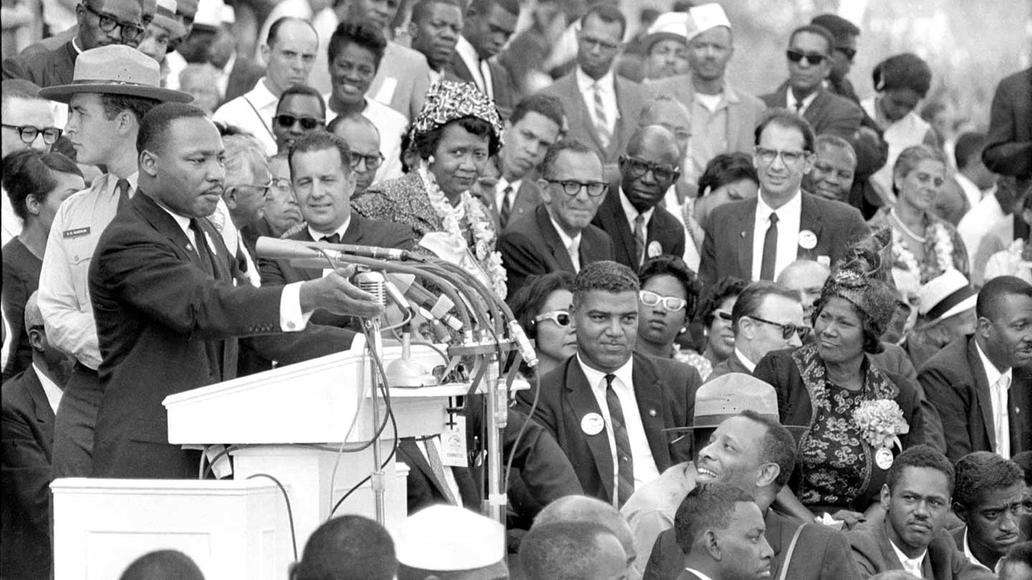
This Photo by Unknown Author is licensed under CC BY
Notes:
The goals of Civil Rights are to ensure equal and consistent treatment for all applicants and participants, provide knowledge of program participants’ rights and responsibilities, eliminate illegal barriers that prevent or deter people from receiving benefits, and promote dignity and respect for everyone.

Slide 6
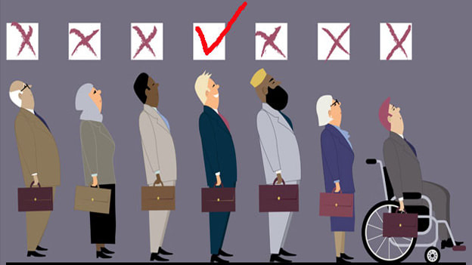
This Photo by Unknown Author is licensed under CC BY-SA-NC
Notes:
There are three types of discrimination. Disparate Treatment is intentional discrimination against someone. Disparate Impact is when actions cause unintentional negative results for a protected class. And Reprisal or Retaliation is an intentional act against someone who opposes discriminatory practices, makes a complaint, or assists in a complaint investigation.

Slide 7
Notes:
An important way to ensure equal opportunity in Extension programs is to provide information about the availability of our programs and services to all people who would be interested in attending or who might benefit from attending. We let people know about their right to access Extension programs and services through fliers, websites, social media, mailings, newspaper, radio, and so on.
In an effort to reach underserved audiences we use targeted outreach through media, community events, and other community organizations to advertise our programs to audiences that don’t traditionally use extension programs and services. When advertising our programs we use language, photos and graphics that convey the message of nondiscrimination. Our program announcements and materials should show diversity in race, age, ability, and so forth.
By knowing the primary languages used by members of the community, information and outreach can also be provided in other languages.
We advise potential clientele that we don’t discriminate by including a non-discrimination statement and accommodation statement on materials. We also inform other groups that we partner with of our nondiscrimination policy and our inability to provide significant assistance to any groups that discriminate.

Slide 8
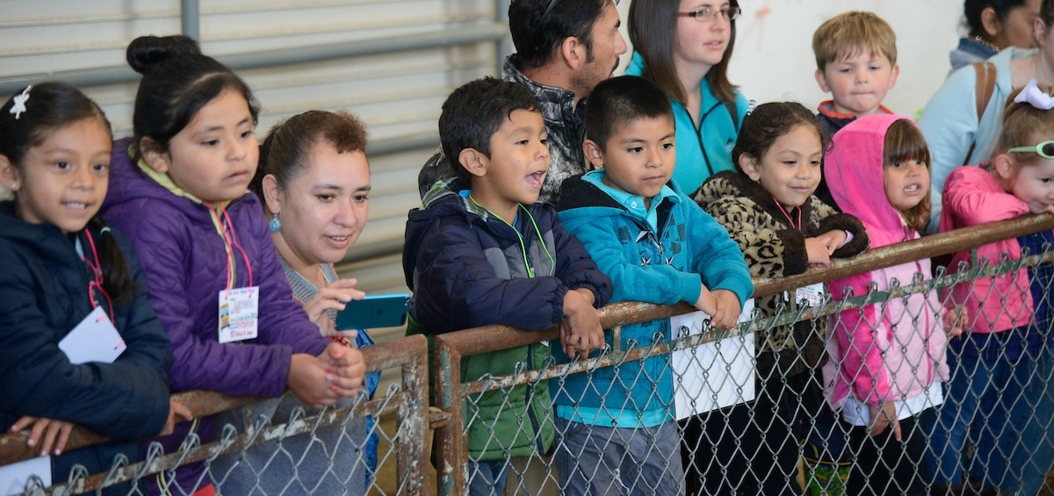
Notes:
The delivery of Extension programs must be done so no one is denied access to our programs. This begins with considering cultural or ethnic differences when planning programs. A great way to make sure we are considering these differences is to increase participation on program planning and advisory committees by under-represented groups. By planning inclusive programming we are more likely to increase participation in programs. We need you as a volunteer or as one of our advisory leaders to help us ensure programs are available to all people within your county that may benefit from participation. Other things we do to increase participation include:
Not having segregated groups or clubs which limit membership based on a protected class.
Providing program accommodations and utilizing accessible program sites to provide access to persons with disabilities.
Providing language assistance for persons with limited English proficiency.

Slide 9
Notes:
When planning and delivering programs, we need to consider barriers that may affect a person’s ability to access our programs. Programs need to be planned in anticipation of special needs, and delivered to maximize access and minimize barriers to participation.
Access barriers to program locations may be significant barriers to program participants. Facilities used to deliver Extension programs need to be accessible to people with mobility disabilities. It is also important to provide the opportunity for those that are hearing or vision impaired to participate in our programs. Your county Extension staff can assist with making accommodations for persons with disabilities.
Language barriers impact potential program participants who do not speak English as their primary language and who have a limited ability to read, speak, write, or understand English. We need to take reasonable steps to ensure meaningful access to programs and activities by person with Limited English Proficiency. Talk to your county Extension staff if language services are needed.
Cultural barriers can limit or even exclude participation by racial, ethnic or religious groups. These barriers may exclude clientele from initially attending a program or activity; or may prevent individuals from returning to future programs or activities. Cultural barriers can arise from scheduling events that conflict with major religious or ethnic holidays or events; holding programs or events in potentially uncomfortable locations such as churches, bars, or private clubs, or in locations where groups were previously rejected; and program activities that include food or activities that are insensitive to religious or cultural dietary or behavioral restrictions.
Finally, economic barriers limit or exclude participation of disadvantaged, racial, and ethnic groups. Examples include: programs, activities that require extensive purchases of equipment or supplies; programs that involve fees, meals, and travel; and programs that are conducted at certain times of the day or certain days of the week.

Slide 10
Notes:
When interacting with others you should ask yourself Am I treating this person in the same manner that I treat others? Have I provided this person with information needed to make necessary decisions? And Am I treating others as I would wish to be treated? Reflection on these three questions will help you ensure all current and potential Extension customers are treated with respect.

Slide 11
Notes:
If you encounter conflict attack the problem not the person. Conflict resolution is about listening and understanding the problem. Keep an open mind and don’t overreact to the situation.

Slide 12
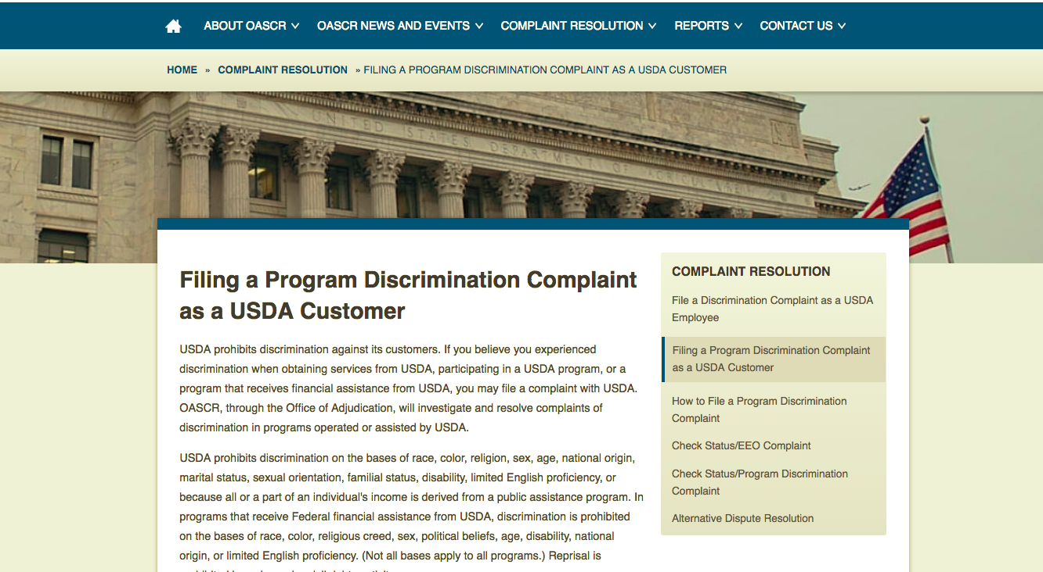
Notes:
People who believe they have been discriminated against have a right to file a complaint. Most civil rights complaints are actually customer service issues such as claims of rudeness, impatience, lack of understanding or compassion. When possible, we want these matters resolved at a local level. If a client reports unfair treatment that they perceive to be based on any of the protected classes or if they simply feel that they have been discriminated against and want to make a complaint immediately let an Extension staff member know so they can help to resolve the situation. All customers or potential customers have the right to file a complaint with NC State University or the UDSA. If an participant asks to file a Civil Rights complaint, refer them to either the information on the “And Justice for All…” poster or to NC State’s Office of Equal Opportunity who will provide them with the instructions for filing a complaint.

Slide 13
Notes:
Extension is required to collect data on the race, ethnicity, and sex of our program participants and contacts. The data is used to assess participation and to target outreach. It’s important that any data you have access to is kept secure and the privacy rights of our participants are maintained.

Slide 14
Notes:
Compliance with civil rights rules and regulations is monitored though internal annual reviews and periodic reviews by the USDA. Extension employees and volunteers are required to cooperate with State and Federal reviewers. If deficiencies are found during an official review, voluntary correction is sought first. However, failure to abide by Civil Rights regulations, instructions and guidance can lead to loss of Federal financial assistance.

Slide 15
NC State Extension prohibits discrimination on the basis of race, color, national origin, age, sex (including pregnancy), disability, religion, sexual orientation, gender identity, genetic information, and veteran status.
If you feel you have experienced discrimination or harassment,
you may file a report with the Office of Equal Opportunity.
https://equalopportunity.ncsu.edu/report-a-concern/

